Slide 1

HARDWARE SPECIFICATIONS
SUBMITTED BY:
GURPREET SINGH(761753)
GROUP #2

Slide 2
CONTENT
Project Overview
Hardware requirements
Main processing unit(Beaglebone Black)
Arduino Mega
GSM Module
WIFI Module
RTC Module
Vibration sensor
Fingerprint sensor
Servo motor
Touchscreen
Buzzer
Other Accessories
Ordering Components

Slide 3
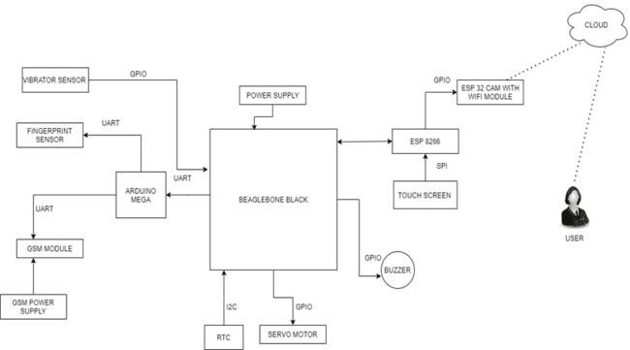
PROJECT OVERVIEW
The project is used to improvise the Bank locker security system. It uses various peripherals and sensors for this purpose.
The IOT based Bank locker security system uses an automated Safety vault with triple layer defense mechanism.
It uses passcode, fingerprint and camera to manage and control the locker effectively.

Slide 4
HARDWARE REQUIREMENTS:
Beaglebone black
Arduino Mega
GSM Module
WIFI Module
RTC Module
Vibration sensor
Fingerprint sensor
Servo motor
Touchscreen
Buzzer
Other Accessories: Soldering kit, resistor/capacitor kit, power supply, SD card, wires and breadboard, Zero PCB

Slide 5
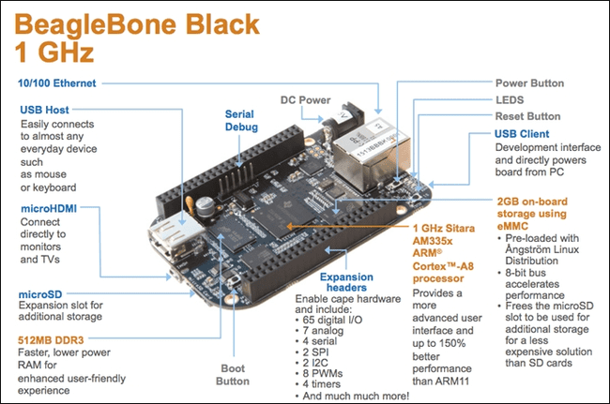
BEAGLEBONE BLACK
BBB is our main microcontroller unit.
It is a low-cost, community-supported development platform for developers and hobbyists.
Boot Linux in under 10 seconds and get started on development in less than 5 minutes with just a single USB cable.

Slide 6
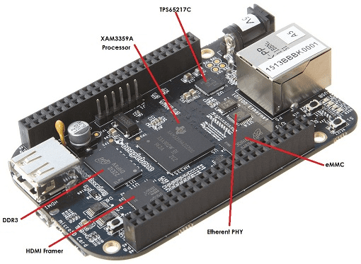
BEAGLEBONE BLACK
AM335x 1GHz ARM® Cortex-A8 processor which is much faster than beaglebone.
512MB DDR3 RAM
4GB 8-bit eMMC on-board flash storage
3D graphics accelerator
NEON floating-point accelerator
2x PRU 32-bit microcontrollers

Slide 7
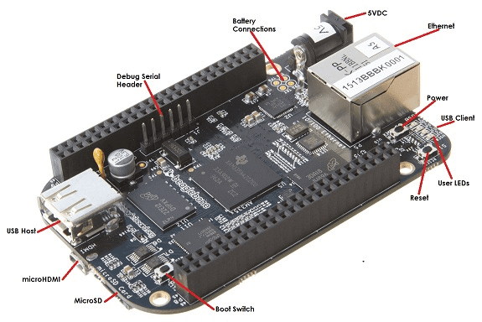
BEAGLEBONE BLACK
It has a range of IO including USB, SPI, I2C, UART, LCD, GPMC, MMC1, MMC2, interrupts, and GPIOs.
Connectivity
USB client for power & communications
USB host
Ethernet
HDMI
2x 46 pin headers

Slide 8
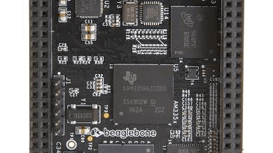
BEAGLEBONE BLACK
Software Compatibility
Debian
Android
Ubuntu
Cloud9 IDE on Node.js w/ BoneScript library

Slide 9
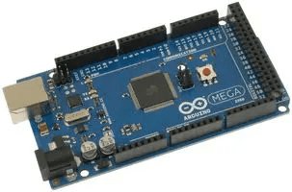
ARDUINO MEGA
Arduino Mega is the slave device in our system for connecting GSM Module and fingerprint sensor.
It is a microcontroller based on the ATmega2560.
The Arduino Mega can be powered via the USB connection or with an external power supply. The power source is selected automatically.

Slide 10
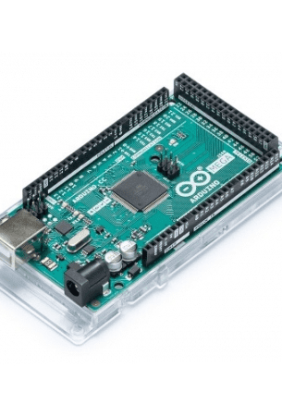
ARDUINO MEGA
The board has 54 digital input/output pins (of which 14 can be used as PWM outputs), 16 analog inputs, 4 UARTs (hardware serial ports), a 16MHz crystal oscillator, a USB connection, a power jack, and a reset button.

Slide 11

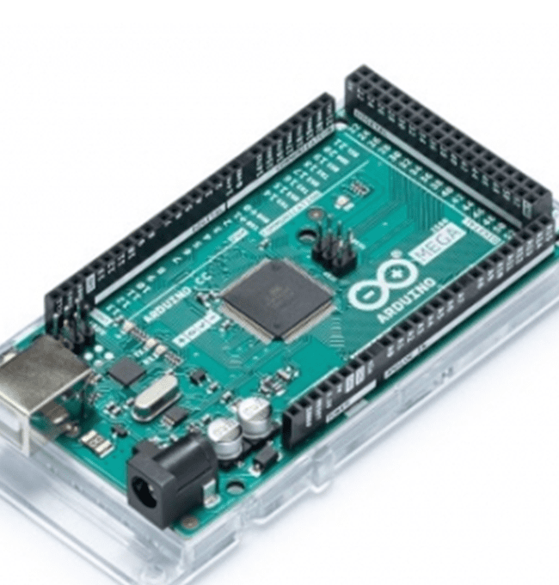
ARDUINO MEGA
5V operating voltage
40mA DC current per I/O pin
256KB flash memory of which 8KB used by bootloader
8KB SRAM
4KB EEPROM
16Mhz clock speed

Slide 12
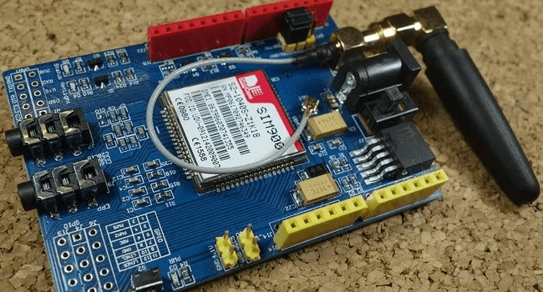
GSM MODULE SIM900 ARDUINO SHIELD

Slide 13
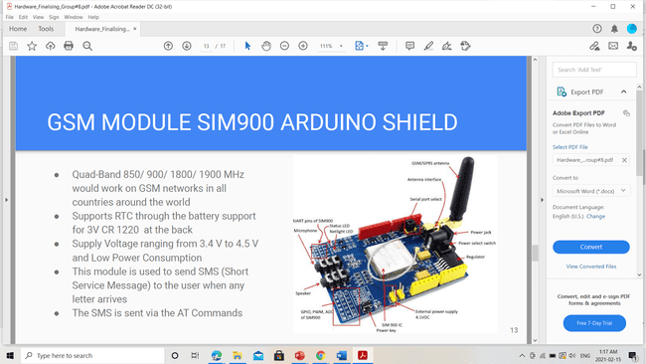
GSM MODULE
Quad-Band 850/ 900/ 1800/ 1900 MHz would work on GSM networks in all countries around the world.
Supply Voltage ranging from 3.4 V to 4.5 V and Low Power Consumption
This module is used to send SMS (Short Service Message) to the user whenever the locker is opened.

Slide 14
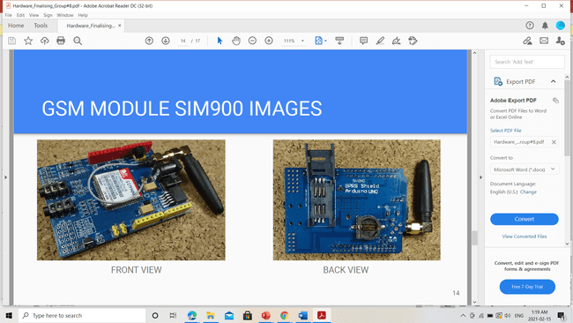
GSM MODULE 900
Front view
Back view

Slide 15
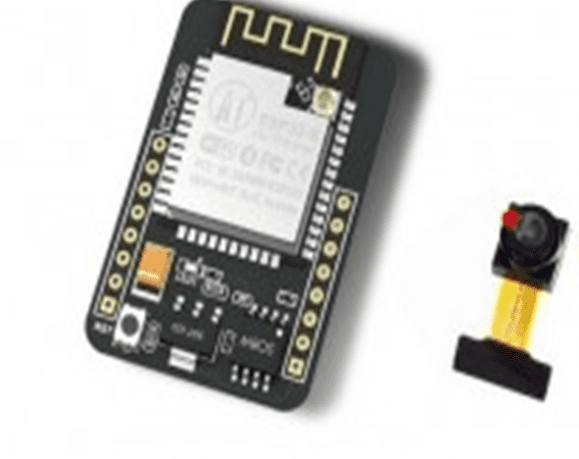
ESP32 MODULE
We are making an IoT based project.
So, it requires internet connectivity.
As Beaglebone Black does not have an inbuilt Wi-fi module, we are using and external module.

Slide 16
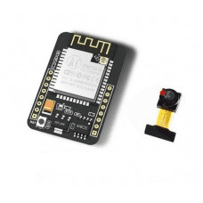
ESP32 CAM MODULE
The ESP32-CAM is a small-sized camera module that can operate independently as a minimum system with a footprint of only 27 x 40 x 4.5mm and a deep sleep current of up to 6mA.
ESP32-CAM adopts a DIP package.
We are using ESP32 CAM Module for taking picture and sending mail.

Slide 17
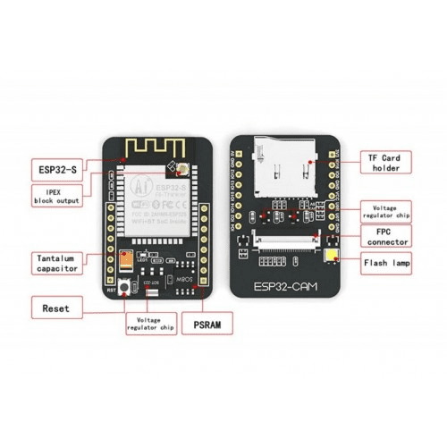
ESP32 CAM MODULE
Features:
The smallest 802.11b/g/n Wi-Fi BT SoC Module
Low power 32-bit CPU, can also serve the application processor
Up to 160MHz clock speed, summary computing power up to 600 DMIPS
Built-in 520 KB SRAM, external 4MPSRAM
Supports UART/SPI/I2C/PWM/ADC/DAC
Support OV2640 and OV7670 cameras, Built-in Flash lamp
Support image Wi-Fi upload
Supports multiple sleep modes
Support TF card

Slide 18
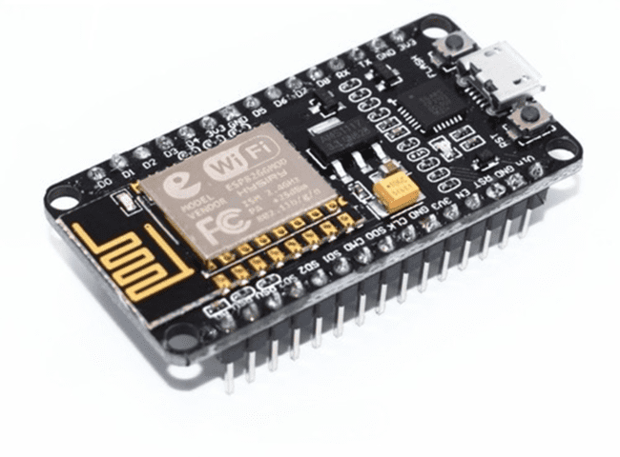
ESP8266
We are using ESP8266 in our project for touchscreen interface.

Slide 19
ESP8266
Features:
802.11 b/g/n
Wi-Fi Direct (P2P), soft-AP
Integrated TCP/IP protocol stack
4MB Flash Memory
Integrated low power 32-bit CPU could be used as application processor
SDIO 1.1 / 2.0, SPI, UART
STBC, 1×1 MIMO, 2×1 MIMO
Wake up and transmit packets in < 2ms
Standby power consumption of < 1.0mW

Slide 20
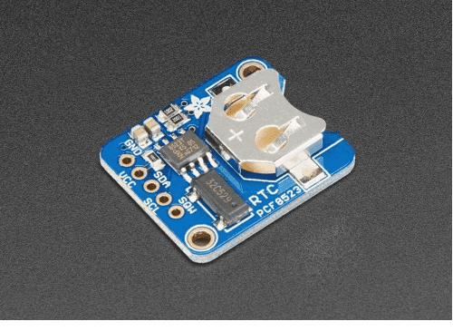
RTC MODULE
Real time clock (RTC) allows microcontroller project to keep track of time.
We are using RTC for keeping track or real time.

Slide 21
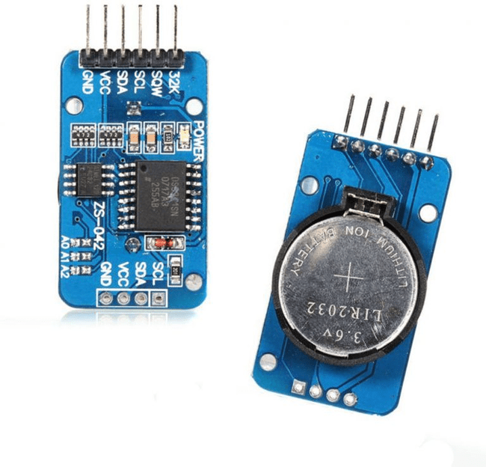
RTC MODULE
Features:
Can function with low voltages
A programmable Square-wave output as per requirement
A battery backup to stay updated even if there is no power
A dual-directional, 400 kHz of I2C interface for speedy transmission
32 bytes of EEPROM for to read/write or to save data
A pushbutton to reset time
RTC can be used either in 12hrs or 24hrs format
An aging trim register to set a user-provided value as an offset with reference to the factory value
Maintains seconds, minutes, hours, days, weeks, months, years information
Switches automatically from a power source to an in-built battery source

Slide 22
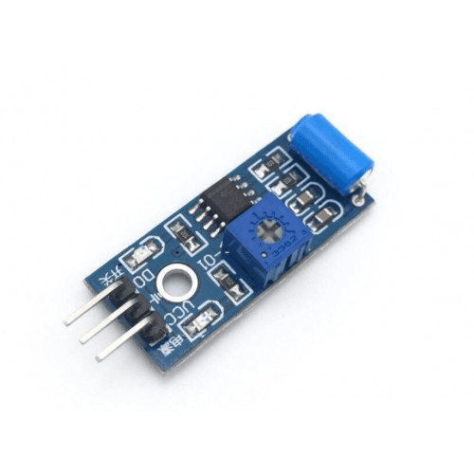
VIBRATION SENSOR
The Vibration sensor is used to detect if there is any vibration that is beyond the threshold. The threshold can be adjusted by the on-board potentiometer. When there no vibration, this module output logic LOW the signal indicate LED light, and vice versa.
It is used in our project to detect vibration as when somebody will try to open the bank locker forcefully, this sensor will start vibrating.

Slide 23
VIBRATION SENSOR
Features
The default state of the switch is close
Digital output Supply voltage:3.3V-5V
On-board indicator LED to show the results
Dimension of the board: 3.2cm x 1.4cm

Slide 24
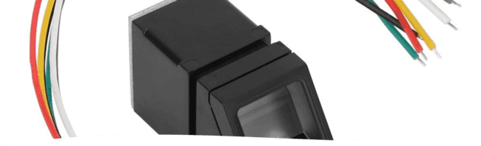
FINGERPRINT SENSOR
The R307 Optical Fingerprint Module integrates fingerprint algorithm chip with functions such as fingerprint entry, image processing, feature extraction, template generation, template storage, fingerprint comparison (1:1) and fingerprint search (1:N).
Fingerprint reader can conduct secondary development and can be embedded into various end products such as: access control, attendance, safety deposit box, car door locks.
Low power consumption, low cost, small size, excellent performance.
Professional optical technology, precise module manufacturing technic.
Good image processing capability, can successfully capture image up to resolution 500 DPI.

Slide 25
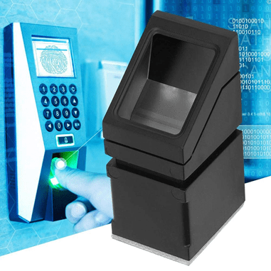
FINGERPRINT SENSOR
The chip has an Ultra-thin optic sensor and SmackFinger 3.0 fingerprint algorithm.
High-speed and accurate fingerprint recognizing technology
Communication may take place through UART or USB interface.
It can Read/Write templates from/to the device.
We are using Fingerprint sensor, for biometric finger authentication.

Slide 26
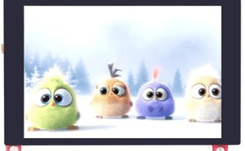
TOUCHSCREEN
3.5-inch screen
Capacitive/Resistive touch control
Supports popular mini-PCs such as Raspberry Pi, BB Black, as well as general desktop computers

Slide 27

TOUCHSCREEN
Specifications:
WIFI/ BLE Connection.
Onboard USB2UART convertor for ESP32 programming
LCD 3.5-inch Amorphous-TFT-LCD for mobile-phone or handy electrical equipment.
LCD Resolution: 320*480
Micro SD card slot on the board
Power Supply: 5V, Type-C USB.

Slide 28
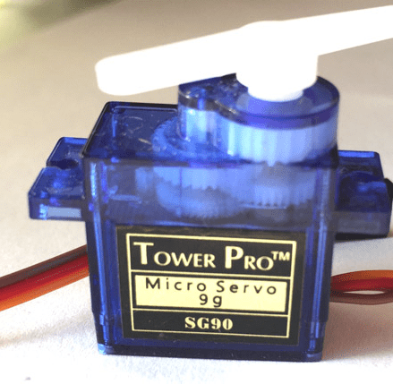
SERVO MOTOR
It is used in our project for lock open and close mechanism.

Slide 29
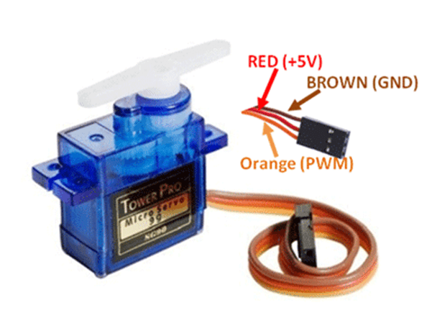
SERVO MOTOR
Features
Operating Voltage is +5V typically
Torque: 2.5kg/cm
Operating speed is 0.1s/60°
Gear Type: Plastic
Rotation : 0°-180°
Weight of motor : 9gm

Slide 30
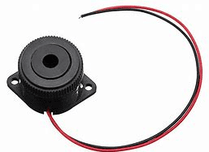
BUZZER
This buzzer is used to give an alert sound when somebody fails to enter the passcode and fingerprints are not matched.

Slide 31
BUZZER
FEATURES:
Rated Voltage: 12VDC
75dB a loud sound for alarm
Active drive inside buzzer and simplify your design, only needs to control buzzer on or off
Widely used in security and home alarm system, or other areas needs sound alarm

Slide 32

OTHER ACCESSORIES
Soldering kit: This kit consists of soldering iron which is used for soldering components to PCB. And there is a digital multimeter that comes with this kit that can be used for testing of components, power supply etc.
Wires and Breadboard: Wires are used for connecting components in breadboard.
Zero PCB: Used to place the Components on the board.

Slide 33
OTHER ACCESSORIES
SD card: To Flash Beaglebone with latest Debian image SD card can be used.
Resistor/Capacitor Kit: It consists of different types of resistors and capacitors used in the project.
Power Supply: 9V is required to Power Up GSM Module and 5V to power up Beagle bone without Laptop.

Slide 34
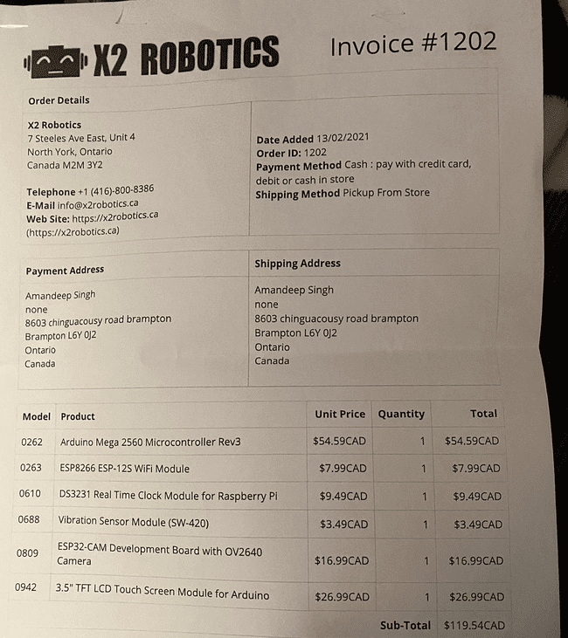
ORDERING COMPONENTS

Slide 35
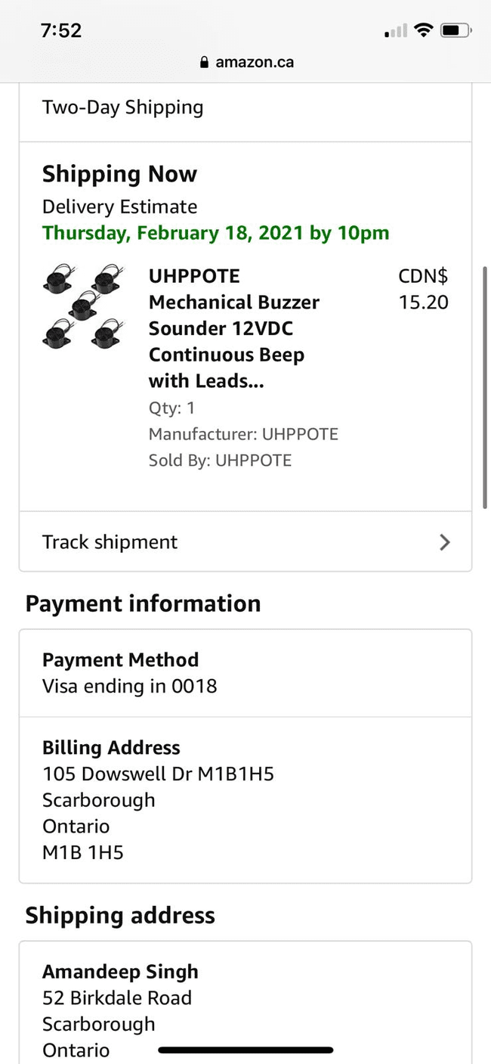
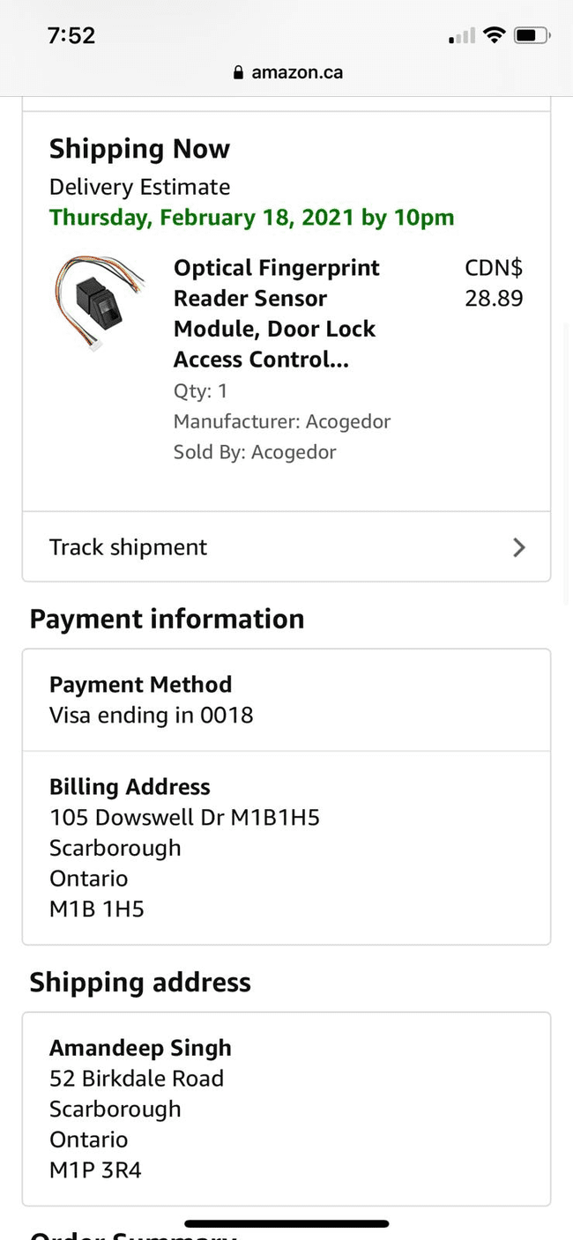
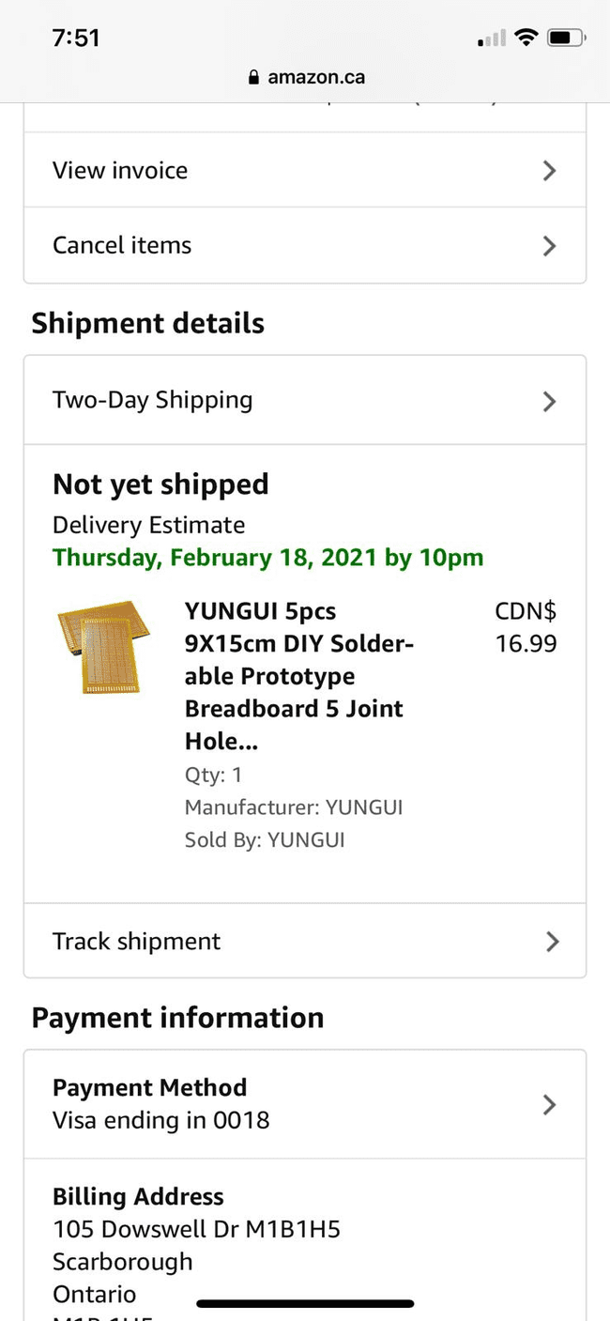
ORDERING COMPONENTS

Slide 36
COMPONENTS THAT WE ALREADY HAVE
Beaglebone Black
Soldering Kit
Resistor/Capacitor Kit
Wires and breadboard
GSM Module
SD Card

Slide 37
REFERENCES
https://elinux.org/Beagleboard:BeagleBoneBlack
https://subscription.packtpub.com/book/hardware_and_creative/9781785285059/1/ch01lvl1sec11/hardware-specification-of-beaglebone-black
SIM900 GSM GPRS Shield with Arduino | Random Nerd Tutorials
Adafruit PCF8523 Real Time Clock Assembled Breakout Board - X2 Robotics in Canada
https://microcontrollerslab.com/ds3231-rtc-module-pinout-interfacing-with-arduino-features/#:~:text=%20Some%20of%20the%20detailed%20features%20are%20listed,with%20reference%20to%20the%20factory%20value%20More%20
Vibration Sensor Module (SW-420) - X2 Robotics in Canada
Servo Motor SG-90 Basics, Pinout, Wire Description, Datasheet (components101.com)

Slide 38
REFERENCES
3-Pack DC 3V-24V Piezo Electric Buzzer Alarm Active Buzzer Loud with 100mm Sound Cable: Amazon.ca: Industrial & Scientific
New Products - X2 Robotics in Canada
https://learn.adafruit.com/adafruit-pitft-3-dot-5-touch-screen-for-raspberry-pi
Optical Fingerprint Reader Sensor Module, Door Lock Access Control Attendance Recognition Device, for Arduino Geekstory: Amazon.ca: Industrial & Scientific
UHPPOTE Mechanical Buzzer Sounder 12VDC Continuous Beep with Leads 75dB for Access Control and Buzz-in System (Pack of 5): Amazon.ca: Camera & Photo
https://www.amazon.ca/YUNGUI-Solder-able-Breadboard-Electronic-Experiment/dp/B07TTD5V2W

